Slide 1
CONFIGURING PERSISTENT STORAGE

Slide 2
Overview
The Kubernetes persistent volume framework allows you to provision an OpenShift Container Platform cluster with persistent storage using networked storage available in your environment. This can be done after completing the initial OpenShift Container Platform installation depending on your application needs, giving users a way to request those resources without having any knowledge of the underlying infrastructure.
This slide deck will focus on NFS Persistent Storage but documentation for NFS, GlusterFS, AWS EBS, iSCSI and many more can be found here:
https://access.redhat.com/documentation/en-us/openshift_container_platform/3.7/html/installation_and_configuration/configuring-persistent-storage#nfs-volume-security

Slide 3
Persistent Storage Using NFS
Overview
OpenShift Container Platform clusters can be provisioned with persistent storage using NFS. Persistent volumes (PVs) and persistent volume claims (PVCs) provide a convenient method for sharing a volume across a project. While the NFS-specific information contained in a PV definition could also be defined directly in a pod definition, doing so does not create the volume as a distinct cluster resource, making the volume more susceptible to conflicts.

Slide 4
Persistent Storage Using NFS
Provisioning
Storage must exist in the underlying infrastructure before it can be mounted as a volume in OpenShift Container Platform. To provision NFS volumes, a list of NFS servers and export paths are all that is required.
You must first create an object definition for the PV and the following are required:
The name of the volume. This is the PV identity in various oc <command> pod commands.
The amount of storage allocated to this volume.
Though this appears to be related to controlling access to the volume, it is actually used similarly to labels and used to match a PVC to a PV. Currently, no access rules are enforced based on the accessModes.

Slide 5
Persistent Storage Using NFS
4. The volume type being used, in this case the nfs plug-in.
5. The path that is exported by the NFS server.
6. The host name or IP address of the NFS server.
7. The reclaim policy for the PV. This defines what happens to a volume when released from its claim. Valid options are Retain (default) and Recycle. See Reclaiming Resources.

Slide 6
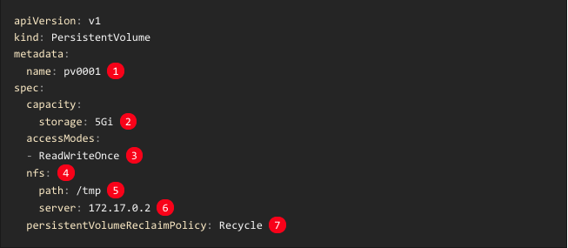
Persistent Storage Using NFS
An example can be seen below:

Slide 7

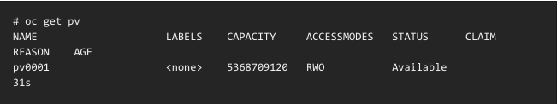
Persistent Storage Using NFS
Save the definition to a file, for example nfs-pv.yaml, and create the PV:
Verify that the PV was created:

Slide 8
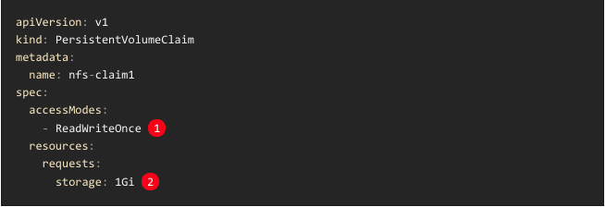
Persistent Storage Using NFS
PVC Object Definition
The next step can be to create a PVC, which binds to the new PV:
As mentioned above for PVs, the accessModes do not enforce security, but rather act as labels to match a PV to a PVC.
This claim looks for PVs offering 1Gi or greater capacity.

Slide 9
Persistent Storage Using NFS
Save the definition to a file, for example nfs-claim.yaml, and create the PVC:

Slide 10
Persistent Storage Using NFS
Reclaiming Resources
NFS implements the OpenShift Container Platform Recyclable plug-in interface. Automatic processes handle reclamation tasks based on policies set on each persistent volume.
By default, PVs are set to Retain. NFS volumes which are set to Recycle are scrubbed (i.e., rm -rf is run on the volume) after being released from their claim (i.e, after the user’s PersistentVolumeClaim bound to the volume is deleted). Once recycled, the NFS volume can be bound to a new claim.
Once claim to a PV is released (that is, the PVC is deleted), the PV object should not be re-used. Instead, a new PV should be created with the same basic volume details as the original.

